Slide 1


Impact of Science Conference the Parallel Session on:
Impact Assessment for Effectiveness
24th June, 2021

Slide 2
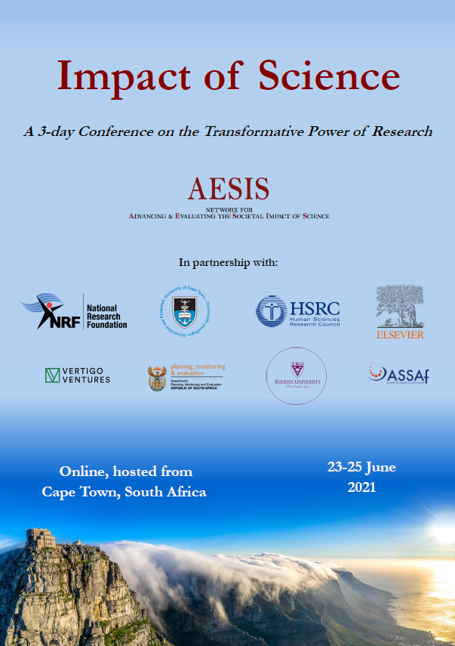

Impact of Science
23-25 June, 2021
Barend van der Meulen (Chair): Professor of Institutional Aspects of (Higher) Education, University of Twente, Netherlands
Heidi Van Rooyen: Group Executive of the Impact Centre at the Human Sciences Research Council, South Africa
Pauline Tay: Strategic Deputy Director Innovation and Enterprise/Strategy, National Research Foundation, Singapore
Overview of the Speakers
#IOS21

Slide 3
Impact of Science
23-25 June, 2021
Barend van der Meulen
Professor of Institutional Aspects of (Higher) Education,
University of Twente, Netherlands
#IOS21

Slide 4
Impact assessment for Effectiveness
AESIS CONFERENCE, June 23-25, 2021 | Cape tOWN
Prof. dr. Barend van der Meulen

Slide 5
Developments in Impact of Science
1970s Impact as a promise related to the project or program.
1990s Impact of science as policy objective that needs to be evaluated
  Cost-benefit analysis of investments in science
  Policy evaluation tools for evaluating impact of science
2000s Impact of science as aspect in research assessments and evaluations
  Indicators of impact
  Project related impact stories.
2020s Impact as strategy of the university
  Global challenges, societal engagement
  Connecting “third mission” with research and teaching
Example Rathenau Instituut
New toolboxes

Slide 6
Mission, measuring, impact
Rathenau Institute The Hague
Mission Policy and debate on science, technology and society
Challenge
Many activities, publications
Political debate issue oriented
No control on political arena
Wide range of outcomes and impacts
Difficult to trace
Difficult to attribute
What we had and did
Communication department responsible for media content and contact
Link impact to mission
Liaison officer for parliament
Improve dedicated publications for parliament
Focus: from 12 to 5 to 3 themes
Monitoring direct results
Create narratives for annual reports and evaluation on long term impacts

Slide 7
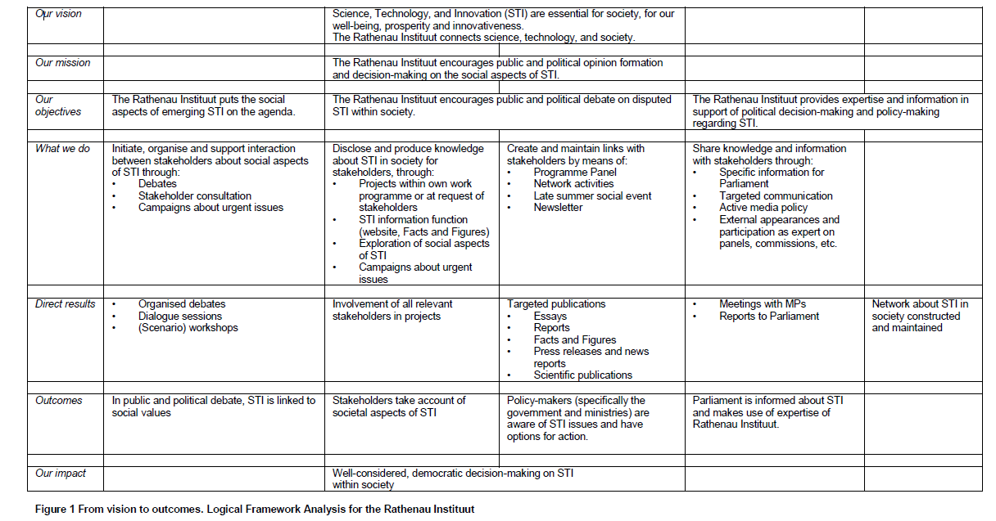
Agenda setting
Analysis of social aspects of STI
Policy support
AESIS CONFERENCE 4-6 NOVEMBER 2020 | KRAKOW | BAREND VAN DER MEULEN
7

Slide 8
Impact on Parliament
Liaison officer for parliament
Regular visits to MPs on science, innovation, higher education
Dedicated publications
  summary of annual science and innovation budget
  policy briefs to prepare parliamentary committee meetings
Workshops for MP staff
Outcomes and impacts
Increased use of reports in debate
  Questions to minister
  References to reports and policy briefs
  Adoption of policy frameworks: funding, social impact of science
Invitations for hearings
Requests for reports
  Assessment of white paper
  Analysing return on investments in science
Impacts on ministries and other stakeholders
8
AESIS CONFERENCE 4-6 November 2020 | Krakow | Barend van der Meulen

Slide 9
Universities with impact
Increasing HE budgets: universities pushed to show their benefit for society
Universities as “policy instruments” for regional and urban development. Employment, new businesses, social resilience,
Open innovation, open science, open higher education
Universities role in responding to sustainable development goals
Combining entrepreneurship, social innovation, engagement, cocreation of knowledge in education and teaching

Slide 10
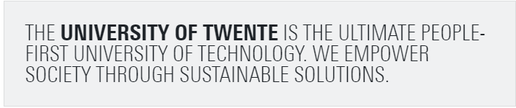
University of Twente Shaping 2030
‘people-first’ : we serve humanity, aware of the interdependencies between people and our planet.
university of technology: We are responsible for ensuring that the power of science and technology is harnessed to achieve the best possible impact in a changing world.
we empower: we enable society to achieve the goals it sets itself by wise use of science and technology
we provide sustainable solutions: we aim for thriving and resilient communities, with an eye for innovation opportunities, with authoritative expertise, and with a keen sensitivity to society’s needs.

Slide 11
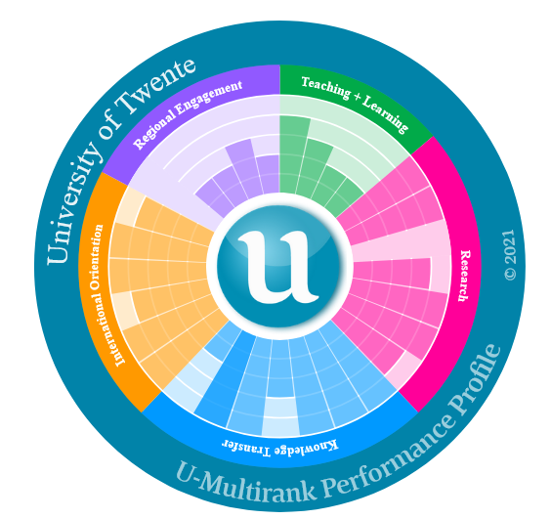
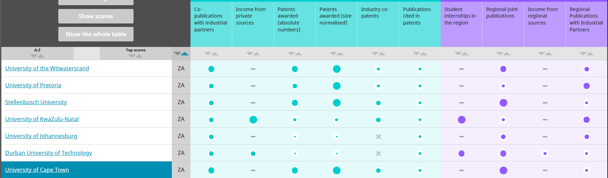
Cheps Toolbox for Assessing IMPACT of University
UMultirank.org
Strategic profiling of universities aimed at
  Students
  University management
  Policy makers
Universities Compared
  850 HE institutes
  70 countries
Multidimensional
  Learning and Teaching
  Research
  Knowledge Transfer
  International Orientation
  Regional Engagement
11

Slide 12
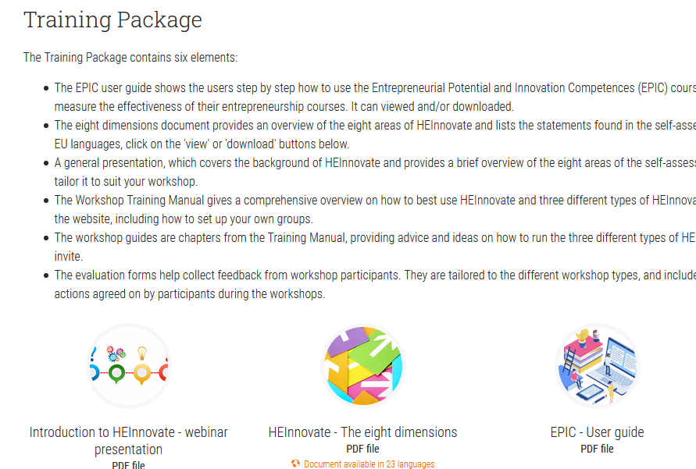
Cheps Toolbox for Assessing IMPACT of University
HEinnovate.eu
EU initiative to support strategic change of universities
Leadership and Governance
Organisational Capacity: Funding, People and Incentives
Entrepreneurial Teaching and Learning
Preparing and Supporting Entrepreneurs
Digital Transformation and Capability
Knowledge Exchange and Collaboration
The Internationalised Institution
Measuring Impact of Change
12
AESIS CONFERENCE 4-6 November 2020 | Krakow | Barend van der Meulen

Slide 13
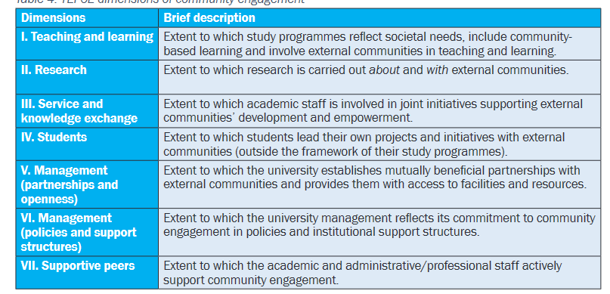
Cheps Toolbox for Assessing IMPACT of University
TEFCE.eu
Framework for Community Engagement in Higher Education
Aim: supporting, monitoring and assessing the community engagement of universities.
Strategic process to strengthen community engagement
  Step 1 Quick Scan
  Step 2 Evidence collection
  Step 3 Mapping report
  Step 4 Participative dialogue
  Step 5 Institutional report
13
AESIS CONFERENCE 4-6 November 2020 | Krakow | Barend van der Meulen

Slide 14
Cheps Toolbox for Assessing IMPACT of University
UMultirank.org
Universities Compared
  850 HE institutes
  70 countries
Multidimensional
  Learning and Teaching
  Research
  Knowledge Transfer
  International Orientation
  Regional Engagment
HEinnovate.eu
EU initiative to support strategic change of universities
Leadership and Governance
Organisational Capacity: Funding, People and Incentives
Entrepreneurial Teaching and Learning
Preparing and Supporting Entrepreneurs
Digital Transformation and Capability
Knowledge Exchange and Collaboration
The Internationalised Institution
Measuring Impact of Change
TEFCE.eu
Framework for Community Engagement in Higher Education
Aim: supporting, monitoring and assessing the community engagement of universities.
Strategic process to strengthen community engagement
  Step 1 Quick Scan
  Step 2 Evidence collection
  Step 3 Mapping report
  Step 4 Participative dialogue
  Step 5 Institutional report
14
AESIS CONFERENCE 4-6 November 2020 | Krakow | Barend van der Meulen

Slide 15
Conclusions and…
Assessing impact has become mature
Effective impact assessment requires strategic commitment
External linkages and perspectives are crucial
…. and more to come
Heidi Van Rooyen. Impact Centre Human Sciences Research Council, South Africa
Pauline Tay. Singapore Business Federation, chair Technology Productivity and Innovation | former National Research Foundation Singapore
15
AESIS CONFERENCE 4-6 November 2020 | Krakow | Barend van der Meulen

Slide 16
Thank YOu
16
AESIS CONFERENCE 4-6 November 2020 | Krakow | Barend van der Meulen

Slide 17
Impact of Science
23-25 June, 2021
Heidi Van Rooyen
Group Executive of the Impact Centre at the Human Sciences Research Council, South Africa
#IOS21

Slide 18
IMPACT ASSESSMENT FOR EFFECTIVENESS
Professor Heidi van Rooyen
Group Executive: Impact Centre
Human Sciences Research Council
Impact of Science Conference: 23-25 June 2021

Slide 19
Presentation overview
1
Why Impact
2
Social Science and Humanities
3
HSRC Mandate
4
Challenges to Impact in the SSH
5
The HSRC’s Impact Centre
6
Conclusions

Slide 20
Inward looking indices of academic impact no longer the ‘gold standard’.
  Citations
  Journal impact factor
  Institutional prestige
  Overvaluation of academic celebrities
Neoliberalist measurement of the “value” of knowledge
  Instrumentalisation of knowledge
  Corporatisation of research institutions
Governments and funding agencies want and expect tangible change(s) in the real world.
  Accountability
  Globally competitive
  Research excellence
Notes:
Not just individual impact, but broader social impact that is asking about the value of what we do, that is asking if the work indeed for the social good: to show and illustrate that. “Impact” is not without contestation
more accurate to speak of the “value” or “influence” of research
questions what it means for blue-skies research

Slide 21
Social Sciences and Humanities in South Africa
“Human and social scientists play a vital role in providing critical analyses of national goals, choices about development policies and strategies, and other national issues pertaining to the transformation of South African society. Their involvement is crucial to a deeper understanding of social issues and to stimulating public debate that could lead to a reconsideration of chosen paths. Equally important to any society that seeks to be innovative in its response to the demands of global change is social research that identifies and explains global trends and their implications in political and economic life, communications and lifestyle changes. Research in the social sciences is therefore of fundamental importance, particularly at this point in our history.”
(Science and Technology White Paper 1996)

Slide 22
HSRC Mandate and Objectives
Section 3, Act 17 of 2008
Initiate, undertake and foster strategic basic and applied research in human sciences | Address developmental challenges by means of projects linked to public sector-oriented collaborative programmes | Inform the effective formulation and monitoring of policy, as well as to evaluate the implementation thereof
Stimulate public debate through the effective dissemination of fact-based research results | Help build research capacity and infrastructure for the human sciences | Foster research collaboration, networks and institutional linkages
Respond to the needs of vulnerable and marginalised groups in society | Develop and make available data sets underpinning research, policy development and public discussion of developmental issues | Develop new and improved methodologies for use in the development of such data sets
Notes:
Fulfil on our mandate to improve our social conditions through generation and dissemination of knowledge
Show our value and legitimacy as knowledge creators
Enhance and reflect on our role as researchers

Slide 23

Impact for the HSRC
Change or benefit to the economy, society, culture, public policy or services, health, the environment or quality of life (UKREF, 2014).
.
A recorded or otherwise auditable occasion of influence from academic research on another actor or organisation (LSE, 2011).
Health, social, economic
(CAHS, 2009).
The good that researcher can do in the world (Reed, 2018).
The planned (and unintended) positive benefit, influence or effect that can be demonstrated to be as a result of the HSRC’s research activities on South African society, the SADC region, continental Africa and globally.

Slide 24
The HSRC Theory of Change
The HSRC has to undertake basic and applied research that will contribute to the alleviation of poverty, a reduction in the inequality gap and the expansion of decent work opportunities for the majority of its people.
Notes:
Globally competitive
Research excellence
Accountability
Reflect on what it means to be a researcher now
Show our value and legitimacy as knowledge creators
Fulfil our mandate to improve social conditions through SSH
“Being at that cutting edge requires us to address the impact visibility and relevance of the research we conduct in the social sciences and humanities for the public good.”

Slide 25
Normative research impact value chain
Research
Outcomes
Academic: citations, reviews, speaking invitations
Public: increased awareness and public discussion
State: changed laws, policies
Impact
(Social change)
Changed behavior and attitudes
Alleviation of poverty and inequality
Enhancing research excellence
Notes:
Big Q: What is “impact” for the social sciences and humanities. What about social impact?
Raise awareness/thinking on social problems
Provide information to the public ultimately to change behavior (societal evidence-led decision making)
Develop methodologies and approaches to do so?

Slide 26








Challenges to research impact
Attribution
Research Impact Evidence
Time Lag
Impact is Developmental
Knowledge Overlap

Slide 27
Impact assessment
Impact is the effect of research-informed products, policies, and services have on end users
Measured in metrics of utilization but also by changes in lives of citizens, health of environment

Slide 28
“Measuring” impact
Typically, create a critical distance between “research” and its “impact”
  suggesting the societal value of research is extraneous to the research itself
Impact on society: top down, undemocratic, reinforces this critical distance between “science” and “society”
Attribute a changed social reality to a particular knowledge product (very hard!)
A uniformed approach across the disciplines fails to capture the nuances of the relationship between society and different forms of knowledge

Slide 29
How Impact is Not a Science
Impact may not lead to trackable material changes, but changes in ideas, thinking and behaviours
Different forms of knowledge have different impacts; impact can be more complex and dynamic
The contribution/attribution dilemma
  How can we know that one particular piece/body of research produced a particular result (e.g. change in social attitude)?
  The hard truth of causation – of this research definitively causing that impact
REF (UK and elsewhere)
  “How has your work and scholarship had impact?”
  Methodology: “describe the impact your work has had?” using case studies.
    How do you tell the story of your work?

Slide 30
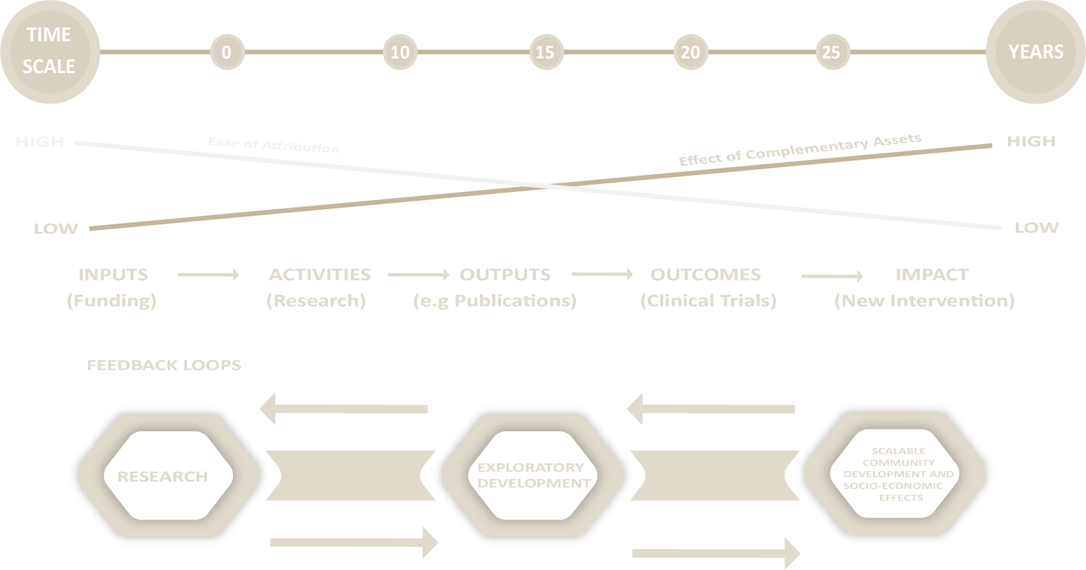
Attribution
Figure 1: Time, attribution, impact: Hughes and Martin (2012)

Slide 31
Time is a crucial factor in the link between research and impact, and time lag varies greatly in between research and impact.
Impact of humanities research may only arise after a much longer time span
Notes:
For instance, there was a time lag of about thirty years between the discovery of DNA and the development of technology for DNA fingerprinting (see Penfield et al., 2014). A similar situation may be true for other fields of research in the Social Sciences and Humanities, Science and Technology, etc.

Slide 32
Link between research and impact is not automatic, requires evidence
This poses a challenge:
  evidence is lacking
  evidence, measurements and baselines have not been properly collected and documented (Penfield et al., 2014).
Duncan Watts :
“Measurement is a tremendous driver of science.”
When you measure things, your conception of the issues –and therefore the solutions – changes.

Slide 33
Impact is dynamic and subject to change over time.
Assessments of impact offer a cross-sectional evaluative judgement in a broad and complex temporal life of impact (Penfield et al., 2014).
  “if impact is short-lived and has come and gone within an assessment period, how will it be viewed and considered? …
Objectives and perspective of those assessing impact key to understanding how temporal and dissipated impact will be valued in comparison with longer-term impact” (Penfield et al., 2014, 26).

Slide 34
Knowledge produced through research does not exist in a vacuum; new and existing knowledge almost always overlaps.
Advances and breakthrough knowledge relies on the accepted and existing knowledge fund, knowledge overlaps creeps between the old and new.
This is a challenge to attribution
  Research evidence from SSH often influences policy debates and policy changes without the recognition of the actual contributing research (see Wooding et al., 2007; Davies et al., 2005).
Sometimes the impact of some research cannot be easily evidenced and it becomes difficult to ensure that such research is valued and supported (Penfield et al., 2014).
Einstein:
“Not everything that can be counted counts, and not everything that counts can be counted.”

Slide 35

The HSRC’s Impact Centre
A multitude of interrelated communication, dissemination and knowledge exchange processes and practices working in a coordinated fashion to appropriately formulate, brand, promote, advocate for and market HSRC research outputs and outcomes.
Focuses and aligns our research activities with various national and regional priorities.
Planned (and unintended) positive benefit, influence or effect that can be demonstrated (through traditional and innovative research methods) to be as a result of the HSRC’s research activities (outputs and outcomes).
VISIBILITY
RELEVANCE
IMPACT
Notes:
The Impact Centre was established with a mandate to strategically direct the HSRC’s research visibility, relevance and impact as pathways and drivers to position the HSRC as the flagship for Humanities and Social Sciences (HSS) research in the South Africa, the SADC region, continental Africa and the globally.

Slide 36
Critical research impact
  Paramount in transformative contexts with deliberate social outcomes that will not be achieved without challenging the status quo
    Ruth Machen, ‘Impact from Critical Research’ LSE Blog (2018)
Challenging Policy
Empowering resistance
Platforming marginalised voices
Supporting new critical publics
Critical analysis of socially inequitable impact of policies
Supporting knowledge, networks and other tools for organising resistance
Listening, supporting, representing and mobilising marginalised voices
Inspiring new critical skills and new forms of public engagement

Slide 37
Research Impact Interrupted
Impact: social change
What are the social issues and critical challenges that require new ideas and new knowledge?
Impact-driven research methodologies
How can we design our research project to affect the change we seek to create?
How do we describe what we do and how/if it works?
New narratives of science
PAR
Accessible research products
Transparent processes and open data
Dissemination strategies and critical partnerships
Notes:
New tools/forms/distributions of knowledge are changing the way in which we (as researchers and as society) explore and understand the world
Are we looking at this the wrong way around, from “research” to impact”?
What happens if we start with “impact”?
How do we push the frontiers of human knowledge and understanding?

Slide 38
Impact Research and Practice Areas
Transformation of South Africa
2. Developing concepts and a conceptual framework to understand how SSH
acts in the world
1. Research to “improve understanding of social conditions
and the processes of social change”
3. Showing impact: research impact
indicators and assessments
Advancing public debate and critical publics
Expanding knowledge base on social conditions
Changing public attitudes and behavior
Platforming marginalised groups/ voices
Informing and analyzing policy and decision-making
4. Enriching the research environment for the HSRC and its researchers
Influencing policy: policy dialogues, policy brief series, evidence synthesis
Informing society: communication campaigns, website, visibility
Enhancing impact skills of HSRC researchers: trainings, seminars and toolkits
Supporting institution-wide strategy on impact
Impact Centre Practice
Notes:
Ensure our research contributes to understanding and addresses poverty and inequality in South Africa
What is the reach and extent of this? a few larger impact studies, does all work lead to impact [in the way it is currently conceived]?
Research, conceptual and technical work
Lead and guide on research, frameworks, tools and theories for building capacities on impact
Work with divisions to ensure implementation
Document the stories/impact for change institutionally
Drive/establish/engage on organizational Impact Culture

Slide 39
Enhancing social impact
Developing and supporting clear strategic executive priorities and objectives for effective social impact.
Developing and coordinating key strategies (Research Use, Communications, Strategic Partnership and Impact Systems) to support this.
Since impact assess is a time and resource intensive exercise the HSRC should have a way of deciding which research projects/programmes are to be assessed for societal impact during a given assessment cycle.
On-going training of researchers on impact design, monitoring and assessment alongside training to enhance a culture and practices of research excellence
How do we describe what we do and how/if it works?
How do we push the frontiers of human knowledge and understanding?

Slide 40

Concluding Remarks
Effective social impact must be explicitly designed and strategically positioned as an institutional priority.
As, Peter Drucker observed, “culture eats strategy for breakfast” - effective social impact must also importantly be an institutional culture giving life and meaning to institutional strategy.
Notes:
Part II of the literature which will focus on two questions:
How can digital artefacts help us foster our own research impact and science communication practices?
How do we foster civic engagement using scientific and creative modalities?
After studying the literature guided by the foregoing questions, we will undertake Part III of the literature review in which we explore the following questions in order to deepen our understanding and practices of research impact within the HSRC and South African context:

Slide 41
Impact of Science
23-25 June, 2021
Pauline Tay
Deputy Director Innovation and Enterprise/Strategy, National Research Foundation, Singapore
#IOS21

Slide 42








I M PACT OF S C I E NC E
CONF E R E NC E 2 0 2 1
AESIS
I M PA C T A S S E S S M E N T F O R
E F F E C T I V E N E S S
D R PA U L I N E E R I C A TAY
C H A I R P E R S O N
S B F S M E C S U B C O M M F O R T E C H N O L O GY,
I N N O V AT I O N & P R O D U C T I V I T Y
S I N G A P O R E
© Pauline Erica Tay

Slide 43
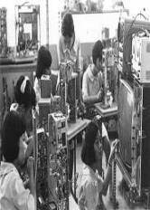
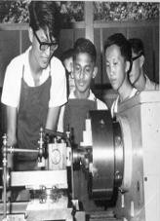









Singapore’s Innovation Journey
Period:
60s
70s
80s
90s
2000s
>2015
Focus:
Employment
Labour Intensive
Capital-Intensive
Knowledge
Economy
Research, Innovation &
Enterprise Development
 | 1991 | 2017 | CAGR
Gross Expenditure on R&D (GERD) | $0.8B | $9.1B | 10%
Business Expenditure on R&D (BERD) | $0.4B | $5.4B | 10.1%
Public Expenditure on R&D (PUBERD) | $0.3B | $3.7B | 9.9%
GERD as percentaage of GDP | 0.96% | 1.94% | -
BERD as percentage of GDP | 0.56% | 1.16% | -
Sources: IPI, National R&D Survey

Slide 44
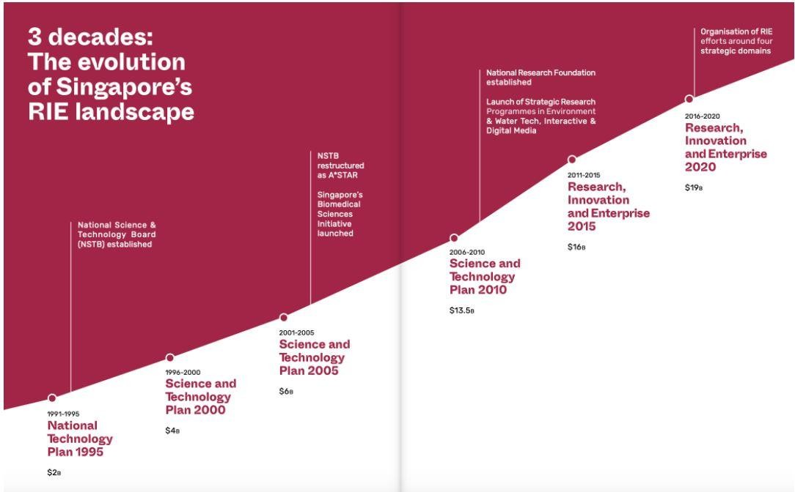
Singapore – Research, Innovation & Enterprise
Source: NRF
© Pauline Erica Tay

Slide 45
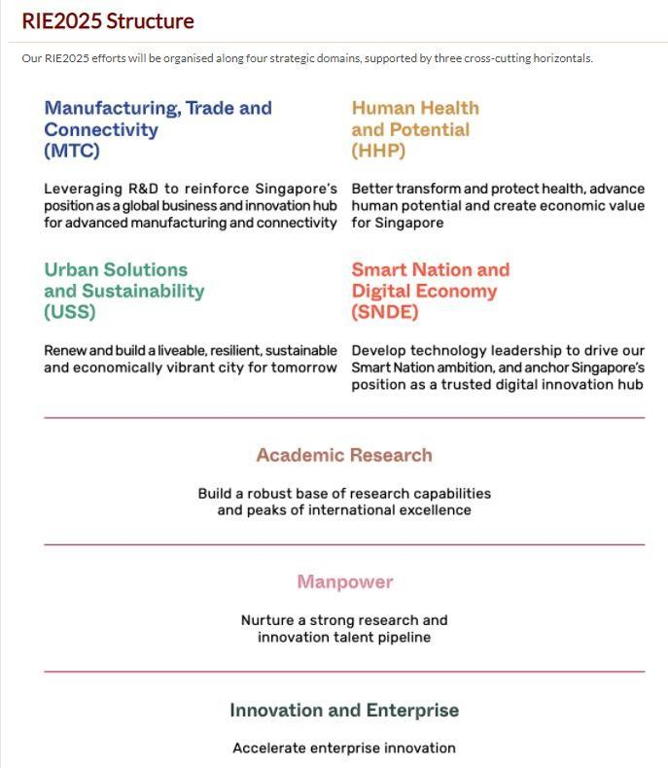
RIE 2025 Strategy
Our RIE2025 efforts are organised along four strategic domains, supported by three cross-cutting horizontals
Source: NRF
© Pauline Erica Tay

Slide 46
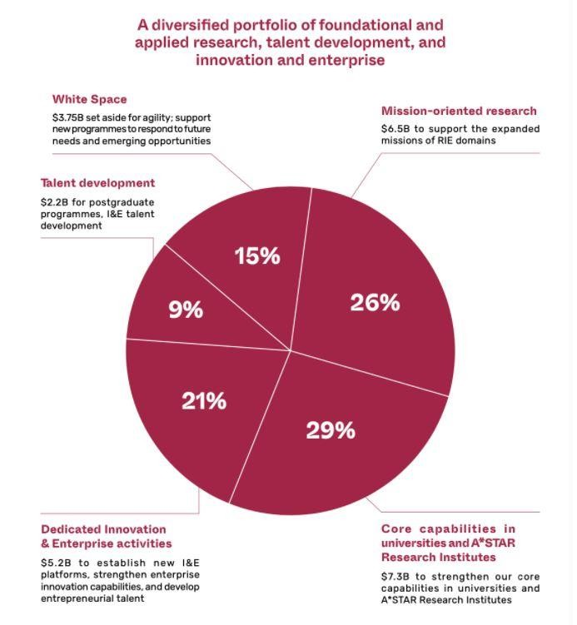
RIE 2025 Budget
The Singapore government sustains investments in research, innovation and enterprise at about 1% of Singapore's GDP over 2021-2025 for RIE2025.
This is about $25B, and reflects the Singapore government’s sustained, long-term commitment to R&D through economic cycles
Source: NRF
© Pauline Erica Tay

Slide 47
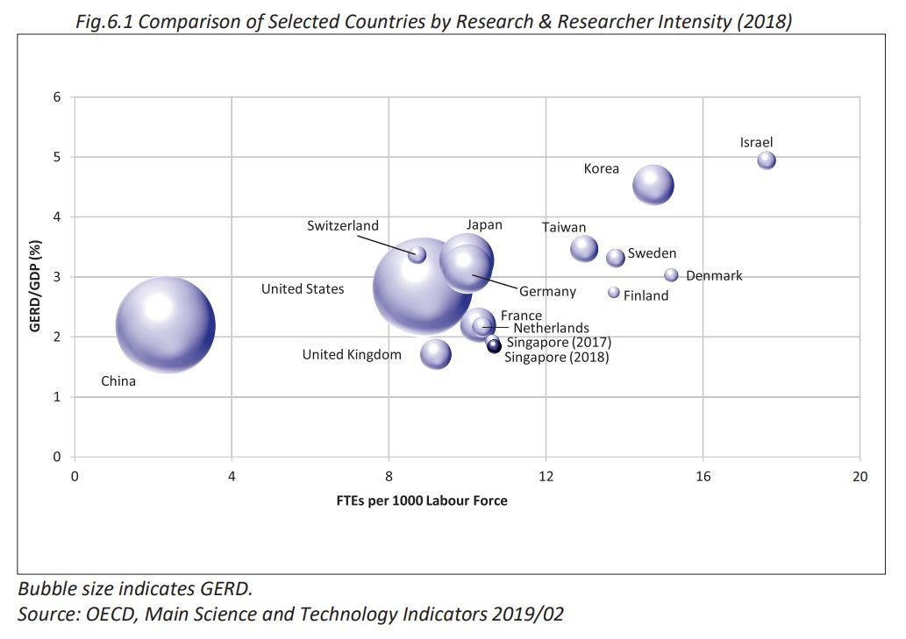
How do countries compare in terms of Research Excellence?
The top 5 most research intensive
countries in the world:
Israel (4.9%)
- Korea (4.5%)
Taiwan (3.5%)
Switzerland (3.4%)
Sweden (3.3%)
According to OECD’s indicators,
US is top R&D spender in 2018, with US$582B spent on research (2.8% of GDP).
China 2nd in 2018, having spent
US$554B (2.2% of GDP)
Japan in 3rd, at US$171B (3.3% of GDP)
Singapore spent 1.8% of GDP on
R&D in 2018.
Source: National R&D Survey
© Pauline Erica Tay

Slide 48
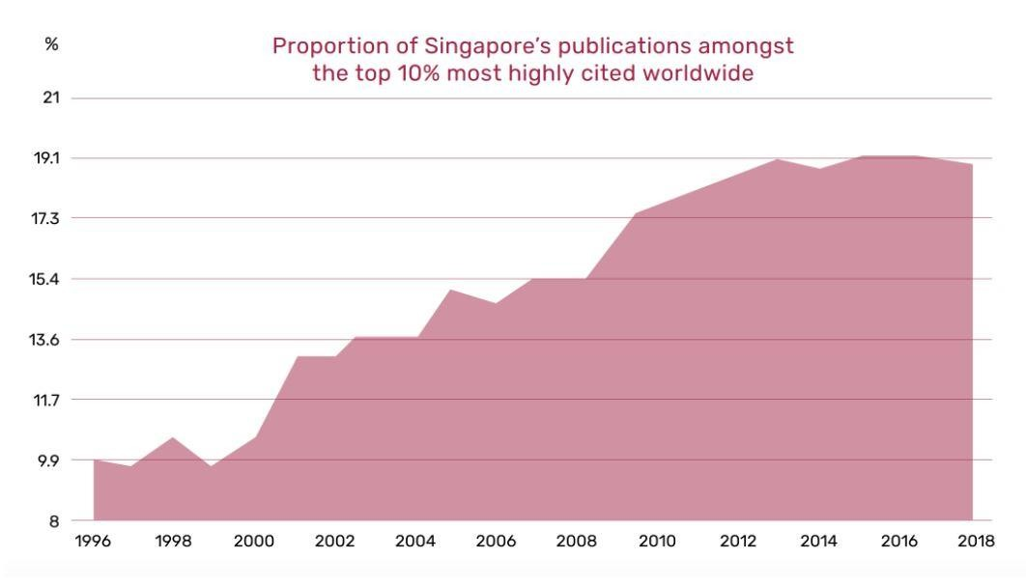
From Research Excellence to Innovation and Enterprise ( I&E) Devt
Whilst we are one of the best in the world for scientific publications & citations, can we evolve beyond scientific performance indicators to innovation/impact indicators?
Sources: NRF
© Pauline Erica Tay

Slide 49
Consider these I&E Impact Indicators
No. of publicly-funded projects translated to POCs
No. of Technology Disclosures
No. of Patents filed
No. of Licenses/Assignments
No. of Patents/IP commercialised
No. of spin-offs/startups
No. of successful spin-offs/startups (various KPIs)
No. of spin-offs/startups that raised follow-on funding
Adapted from: Singapore Govt Agencies
© Pauline Erica Tay

Slide 50
Consider these I&E Impact Indicators
No. of collaborative projects with corporates
Amount of industry dollars raised
Imputed Commercial Value derived from commercialisation of licensed IP/collaboration
through public-private partnerships
No. of tech talent recruited/developed/retained
No. of tech talent deployed/contributing to industry
No. of international engagements/projects
Impact created from international engagements/projects (various KPIs)
Value created/anchored in country of origin
Adapted from: Singapore Govt Agencies
© Pauline Erica Tay

Slide 51
Impact Assessment of Science through
Innovation & Enterprise ( I&E) Development
Vibrant and dynamic I&E ecosystem
Singapore has a vibrant and dynamic I&E ecosystem.
Since 2014, Singapore has maintained its position as the top innovative nation in Asia Pacific on the Global Innovation Index, an annual ranking of 130 economies compiled by the World Intellectual Property Organisation, Cornell University and INSEAD.
Private sector R&D activity increased with annual business expenditure on R&D (BERD) growing
from $1.5B in 1998 to $5.6B in 2018.
Global companies have invested strongly in Singapore, creating a vibrant innovation and tech ecosystem here.
80 of the world’s top 100 tech companies have established a presence here (e.g. Google and
Facebook). Through platforms such as corporate laboratories and technology consortia,
Our startup ecosystem has also grown in vibrancy, with about 36,000 startups choosing to locate
themselves in Singapore, many of which are built around deep tech.
Source: NRF
© Pauline Erica Tay

Slide 52
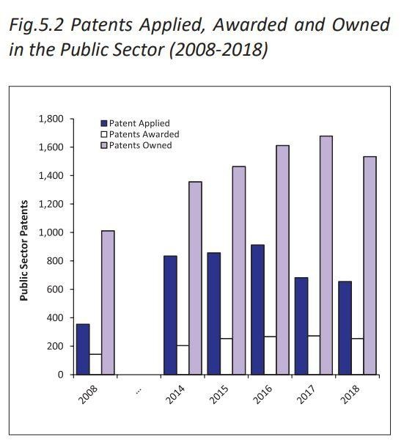
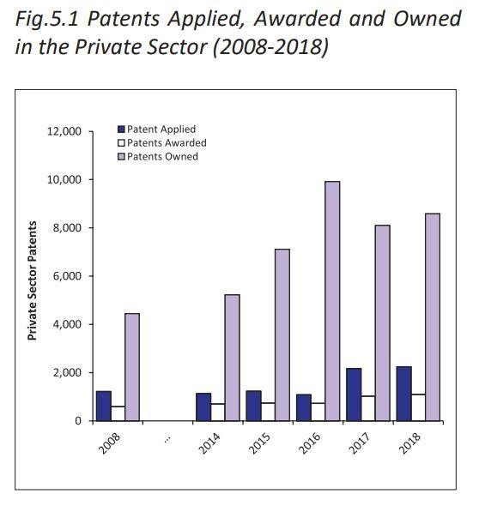
Patents Filed/ Awarded/ Owned vs Commercialised?
In 2018, the total number of primary patent applications (first filings) as a result of R&D conducted in Singapore stood at 2,896. This represents a CAGR of 6.2% from 1,581 patents filed in 2008.
Fig 1
Fig 2
Instead of measuring no. of patents filed/awarded, we should be measuring no. of patents successfully commercialised/impact to industry/society
Source: National R&D Survey
© Pauline Erica Tay

Slide 53
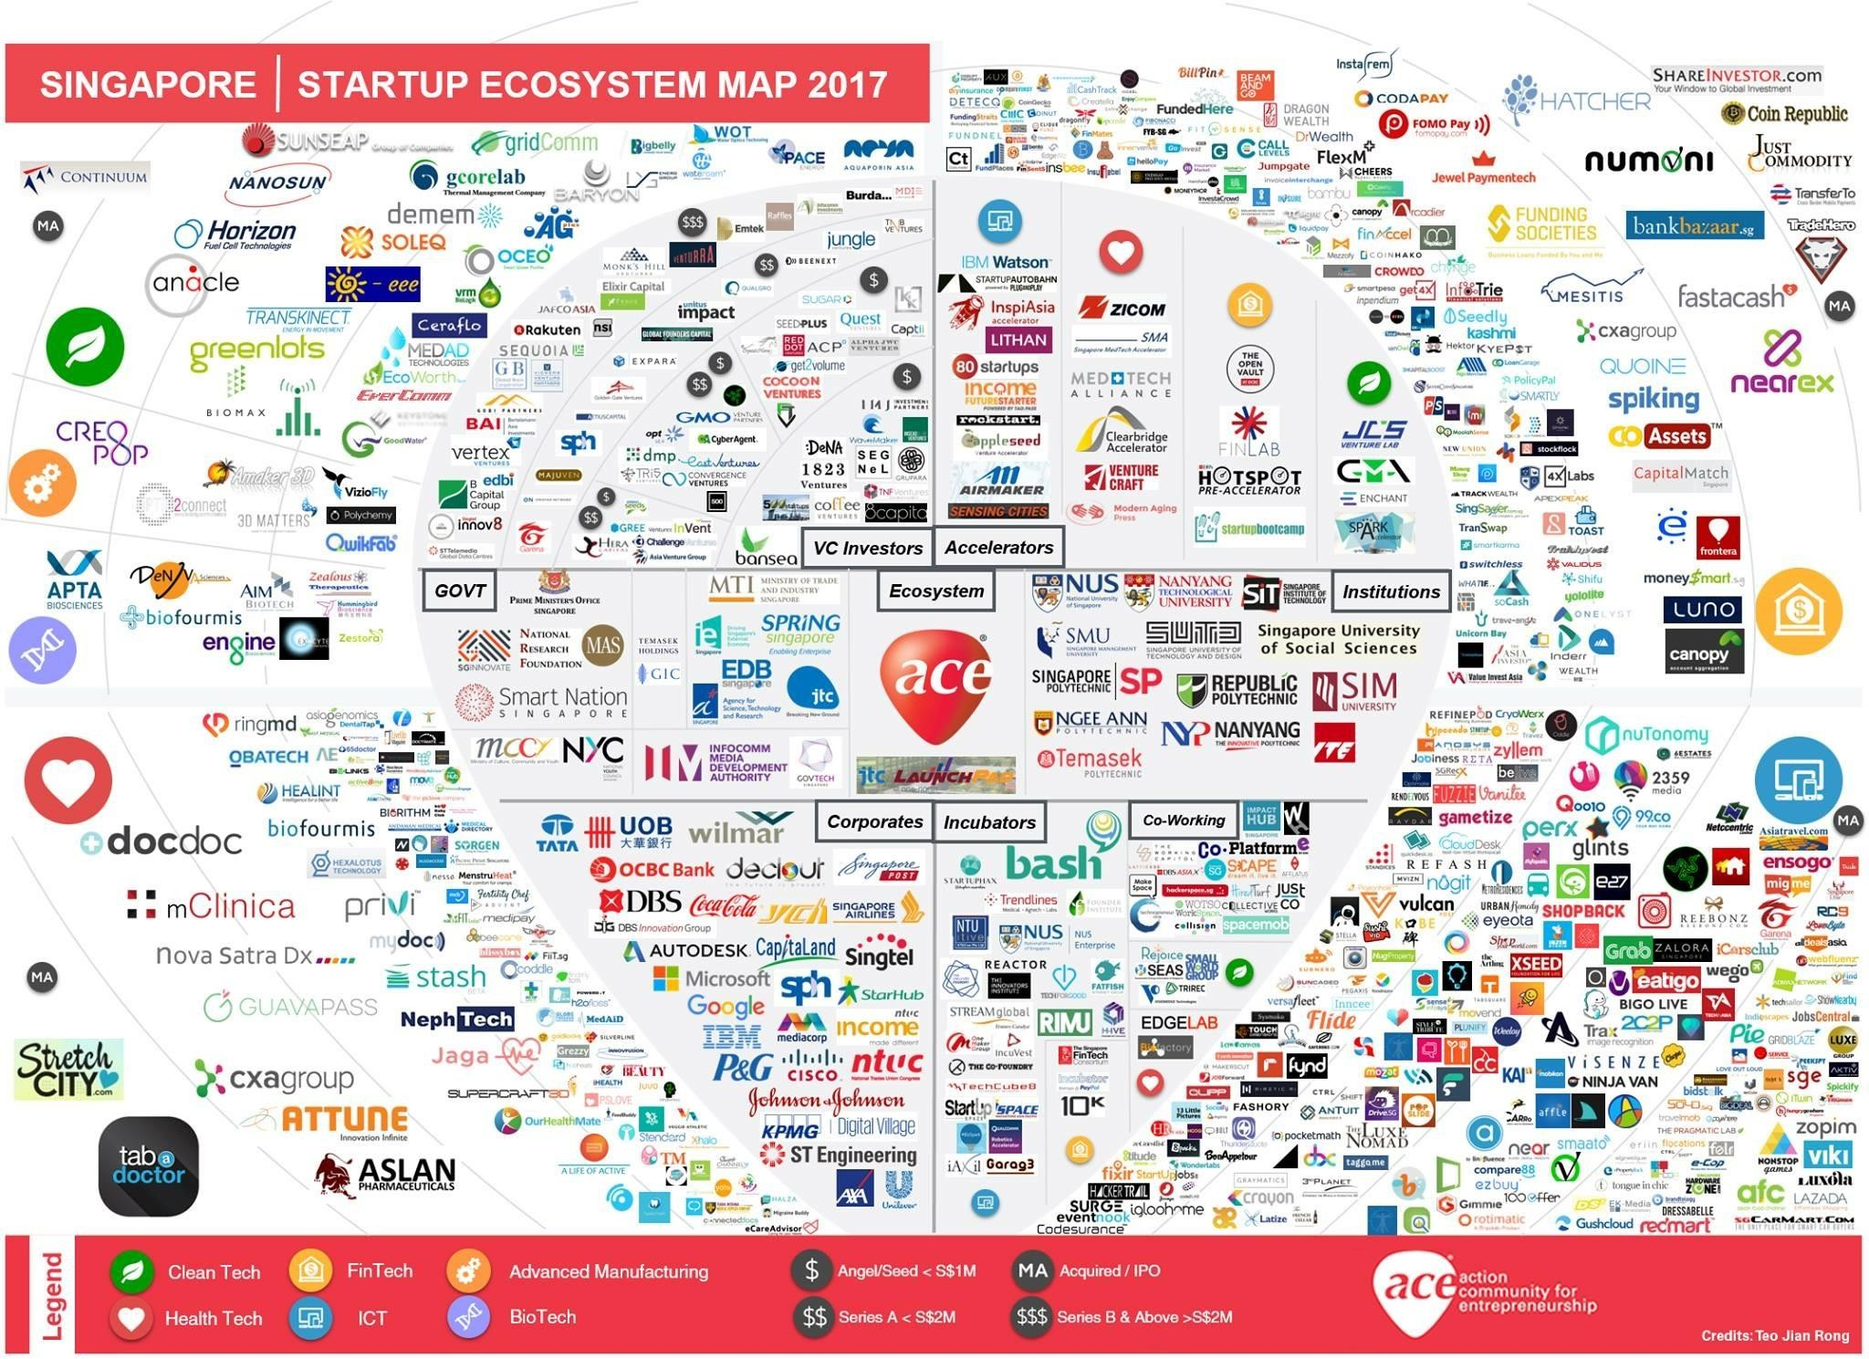
Singapore – A Vibrant Innovation/ Startup Ecosystem
Singapore was voted as the second- easiest place to do business in the world by the World Bank in 2019
Singapore also claimed the title of world-leading technology innovation centre
Unique position at the heart of the ASEAN
Easy access to talent, capital and research organizations
Perfect gateway for startups and scale-ups to access and scale in Southeast Asia.
Advanced IT infrastructure, strong government support, IP laws & deep tech talent pools
Sources: ACE/ESG
© Pauline Erica Tay

Slide 54
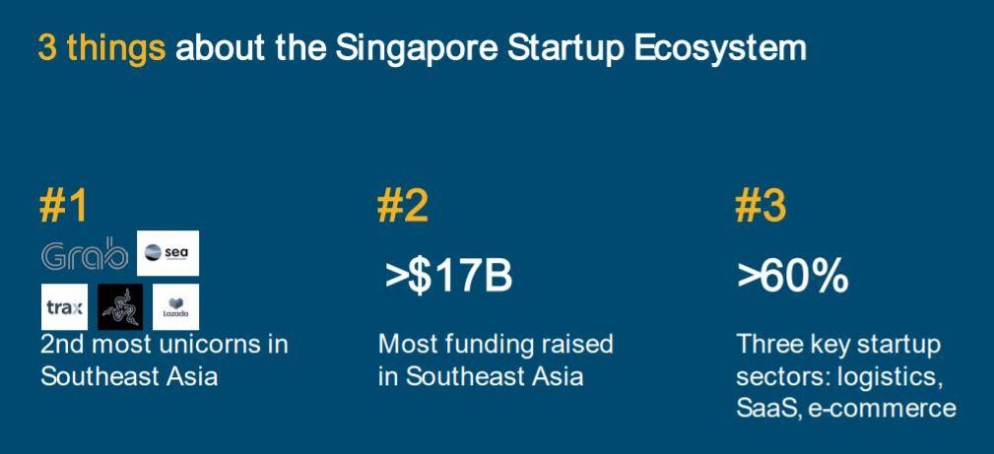
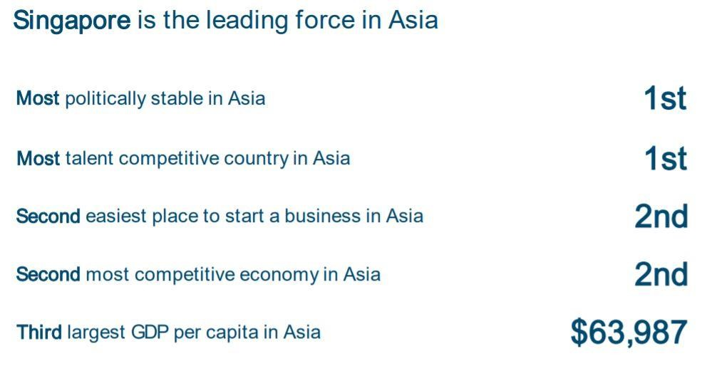
Singapore – A Vibrant Innovation/ Startup Ecosystem
Source: Independent study by the Kingdom of Netherlands
© Pauline Erica Tay

Slide 55
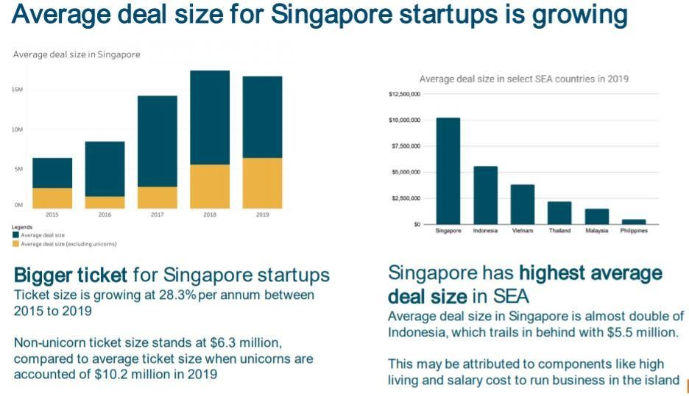
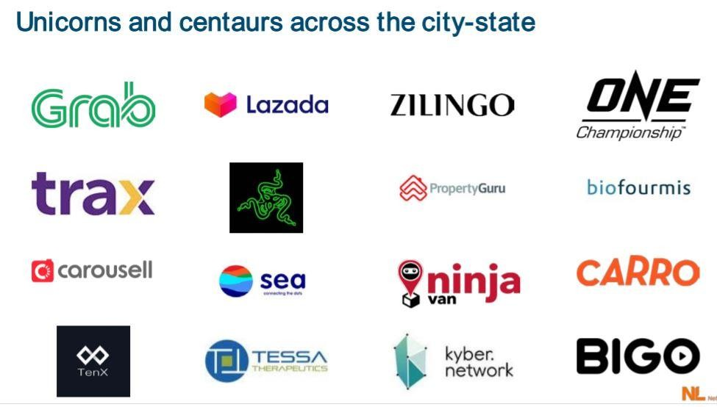
Singapore – A Vibrant Innovation/ Startup Ecosystem
Source: Independent study by the Kingdom of Netherlands
© Pauline Erica Tay

Slide 56
Resources
RIE2025 Plan: https://www.nrf.gov.sg/docs/default-source/default-document- library/rie_booklet_fa2021_pages.pdf
National R&D Survey 2018: https://www.a- star.edu.sg/docs/librariesprovider1/default-document-library/news- events/publications/national-survey-of-r-d-2018.pdf
Singapore, Hub of Innovation: file:///C:/Users/Pauline/Downloads/Singapore+startup+ecosystem_Oct2020_p p_NL_v1.pdf
Enterprise Singapore StartupSG: https://www.startupsg.gov.sg/
ACE Singapore Startup Ecosystem: https://ace.org.sg/singapore-startup- ecosystem-an-overview/
https://www.russellbedford.com/latest/news/singapore-retains-second-place-
in-2019-world-bank-doing-business-report-ranking/
© Pauline Erica Tay

Slide 57

Questions?
paulinericatay@gmail.com
© Pauline Erica Tay

Slide 58
Impact of Science
23-25 June, 2021
Thank you
#IOS21

